Slide 1
NPRE 321 Introduction to Plasmas and their Applications
Research Associate Professor Daniel Andruczyk
Hybrid Illinois Device for Research and Applications
Center for Plasma Materials Interactions
Department of Nuclear, Plasma and Radiological Engineering
University of Illinois Urbana-Champaign
3 Hours of Lectures per week
Including Practicums

Slide 2
LECTURE 29
Practicum IV:
Fusion – Hybrid Illinois Device for Research and Applications (HIDRA)

Slide 3
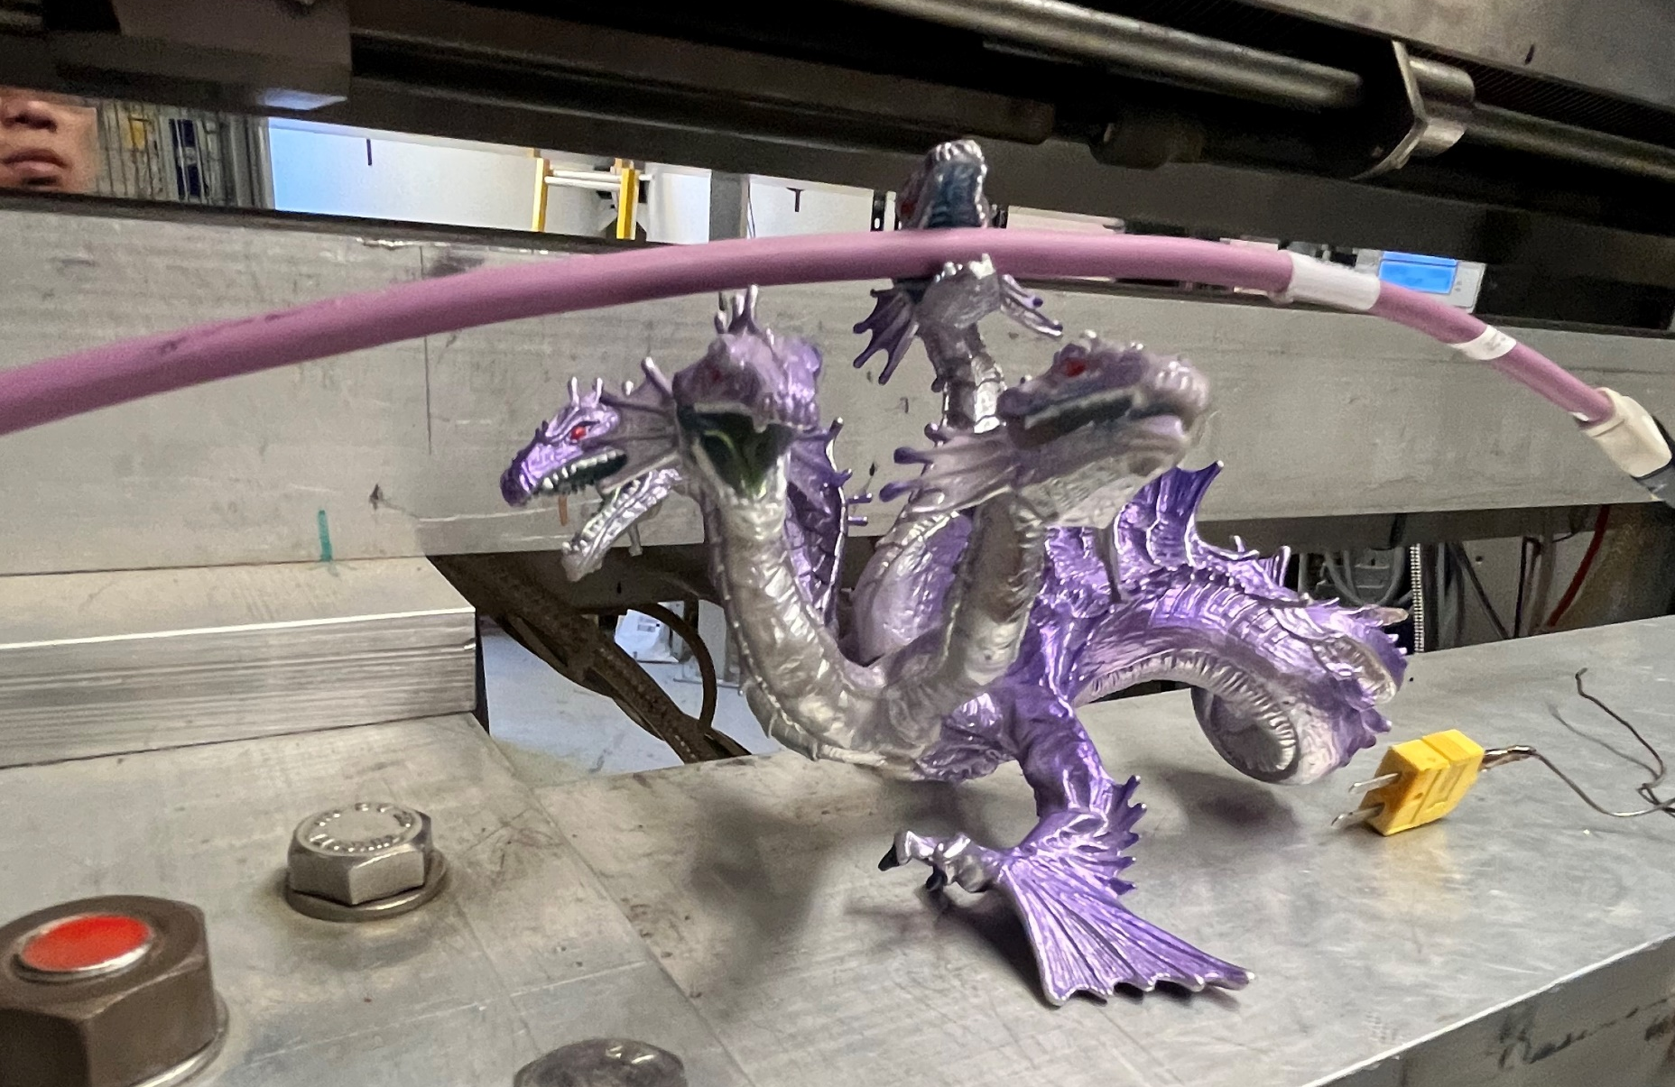
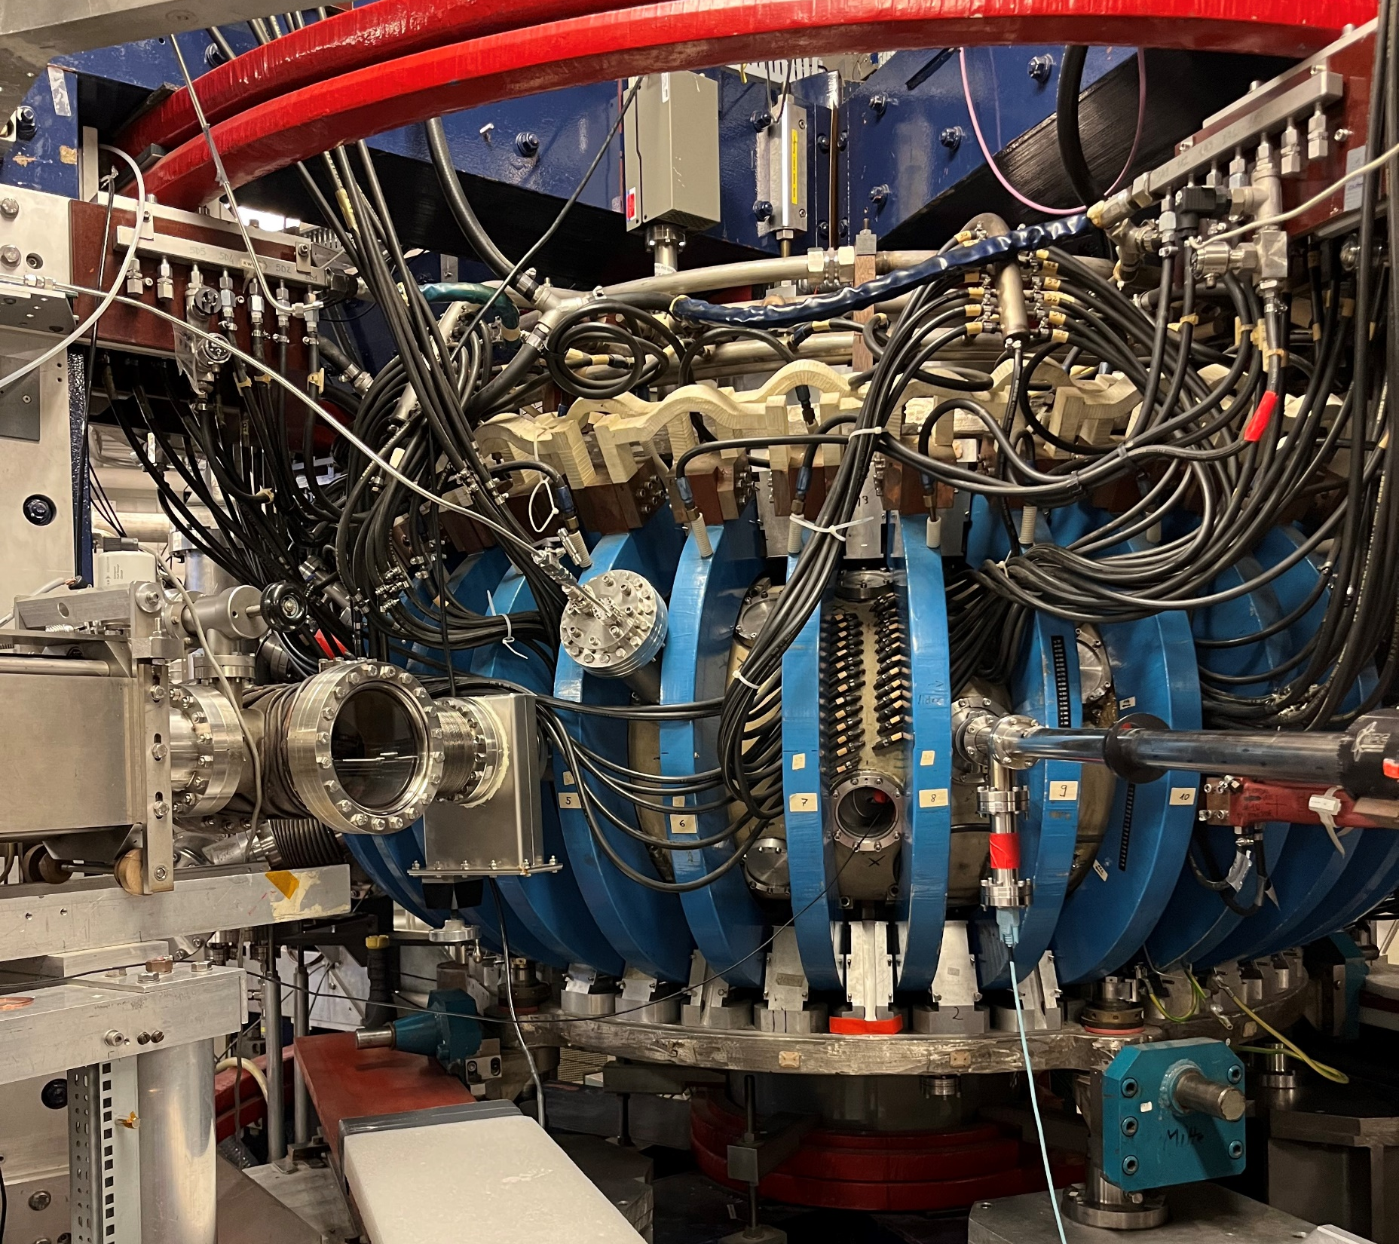
Practicum Laboratory #3: FUSION - HIDRA Student Name: Joseph Specht Practicum Date: 11/15/23
Introduction:
There was no experiment shown today, but rather a tour of HIDRA (Hybrid Illinois Device for Research and Applications was given. During this tour, we were told about the fusion device that was built in France, sent around Germany, and finally ended up in CMPI. This device was sent from Germany from a University that was going to discard it, but it was instead sent to UIUC on a $1 contract that ended up costing $200,000 in shipping fees.
HIDRA is a hybrid tokamak and stellarator, which allows it to run with or without a central solenoid.
The tokamak mode uses the blue magnets seen in the picture to the right and a central solenoid that is concentric with the pictured torus. The blue magnets generate a toroidal field that runs along the center of the device, while the central solenoid generates a poloidal field that wraps around the device. While in tokamak mode, this device is a pulse machine.
The stellarator mode also uses the blue magnets, which are coupled with the black helical coils that wrap the device 5 times in a single revolution. This mode is steady state by design.

Slide 4
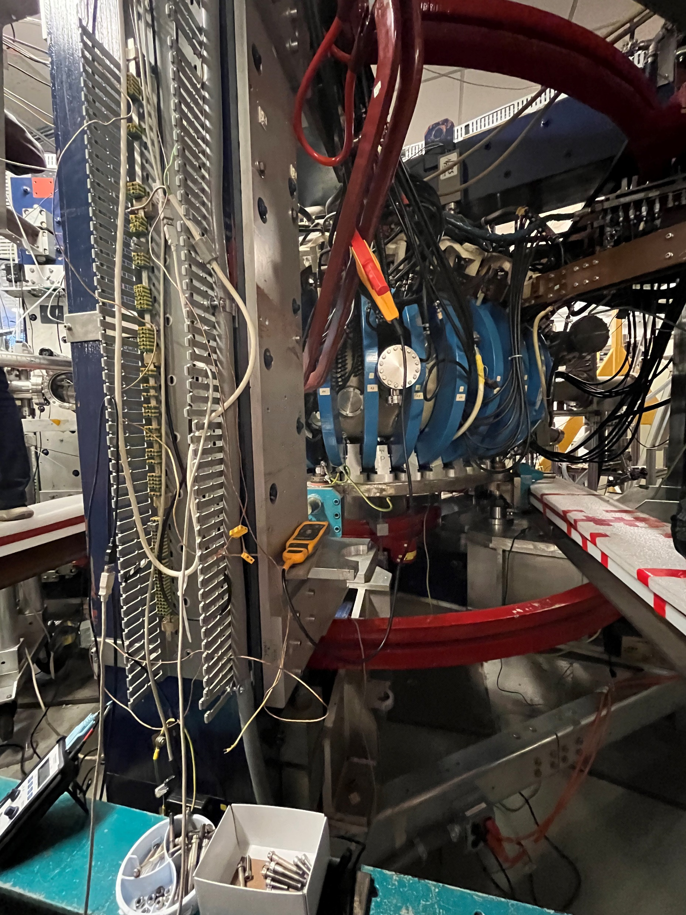
Introduction (continued):
HIDRA does not get hot or dense enough to carry our fusion experiments, so it is used to test plasma’s interactions with materials hence the name of the laboratory.
This machine first is sealed and prepped to become a vacuum chamber by first running a rough pump followed by a turbo pump, then a plasma of Helium is pumped in through the device and contained with the different sets of magnets depending on which mode the device is in.
There is much difficulty in containing the plasma and one of the grad students described it like trying to compress Jello with rubber bands.
The currents inside the toroidal magnets get up to 3500 amps & the currents inside the helical coils get up to 7000 amps.

Slide 5
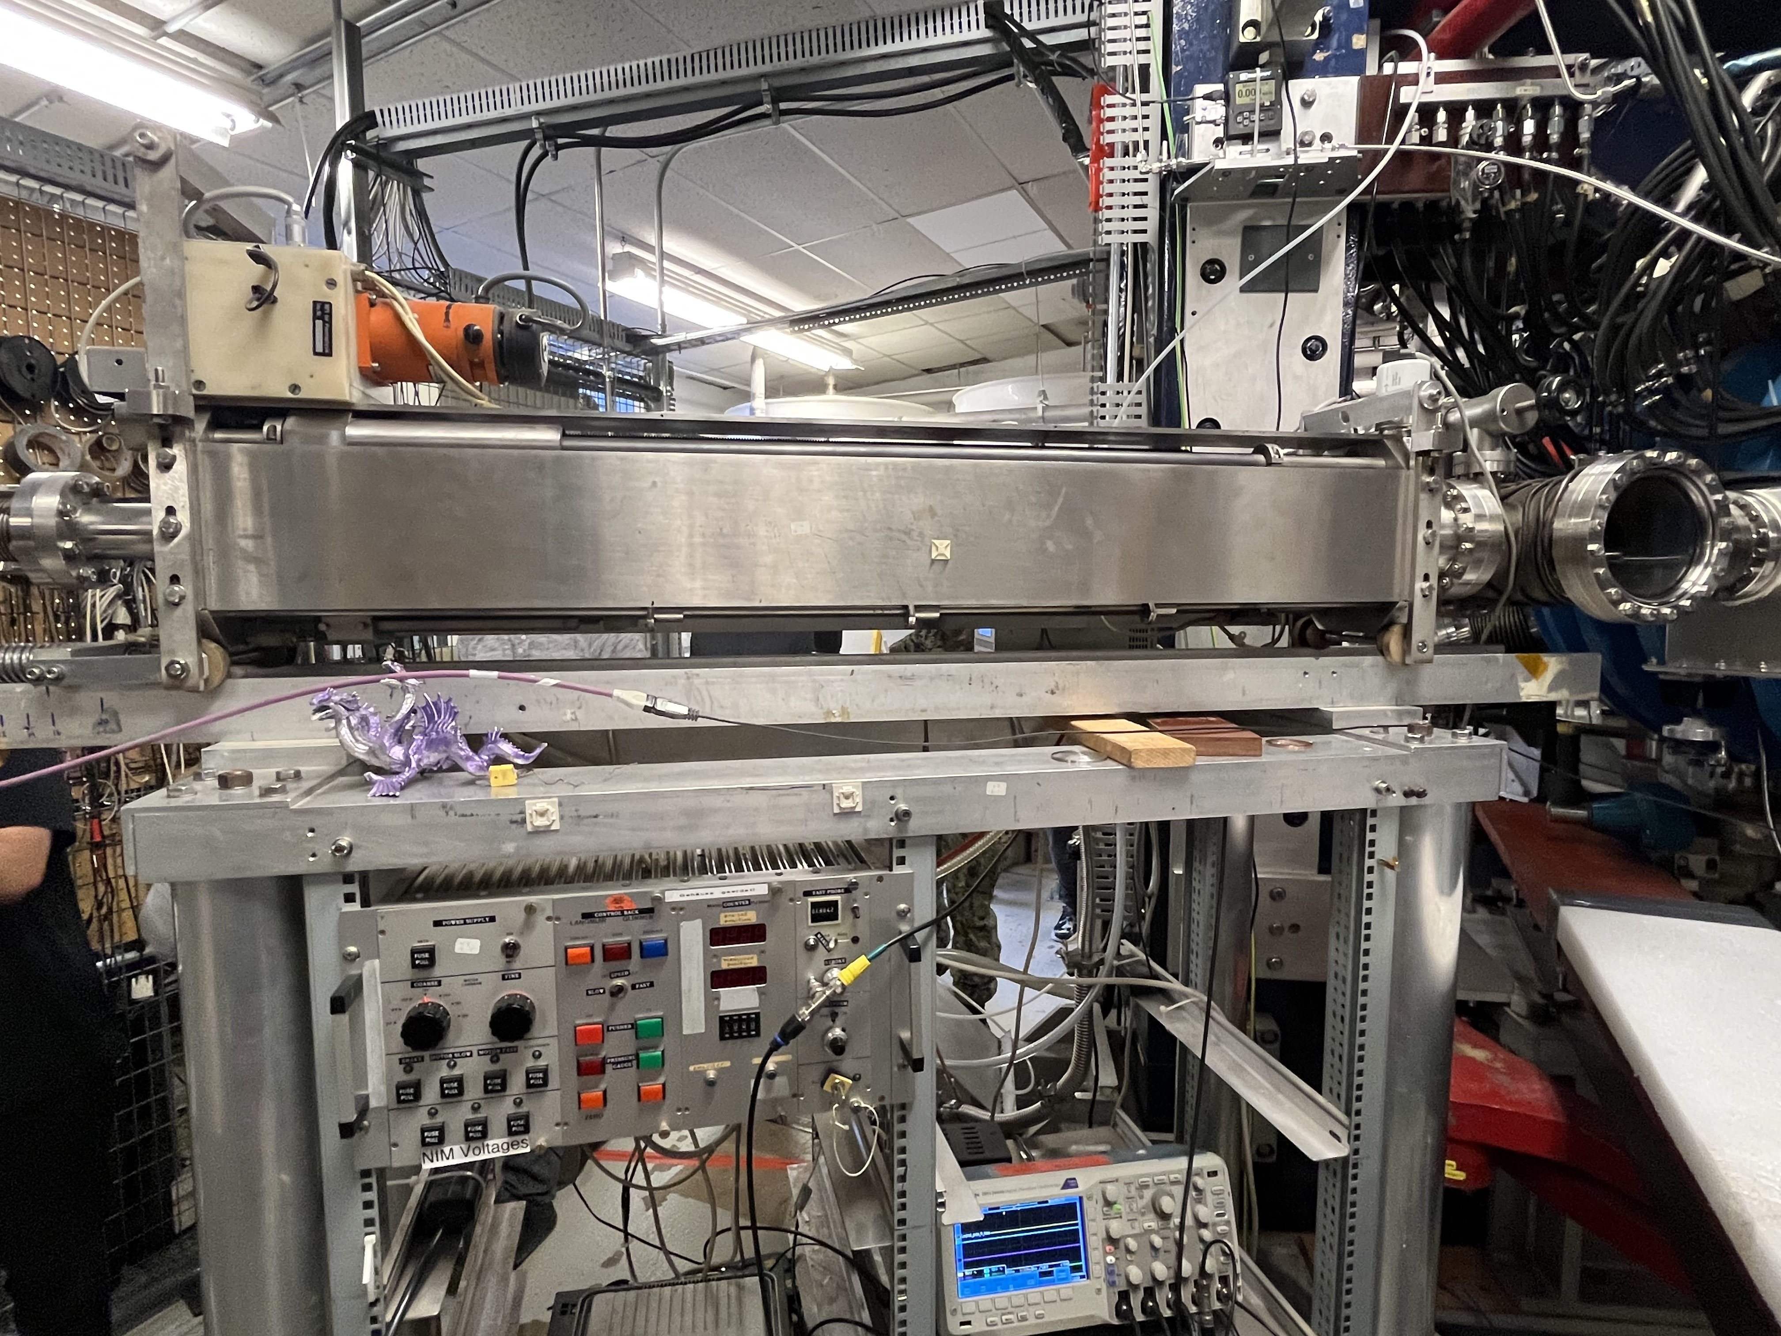
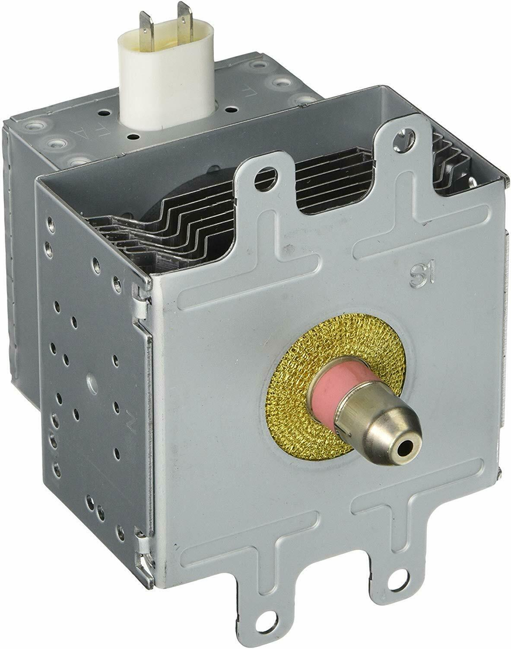
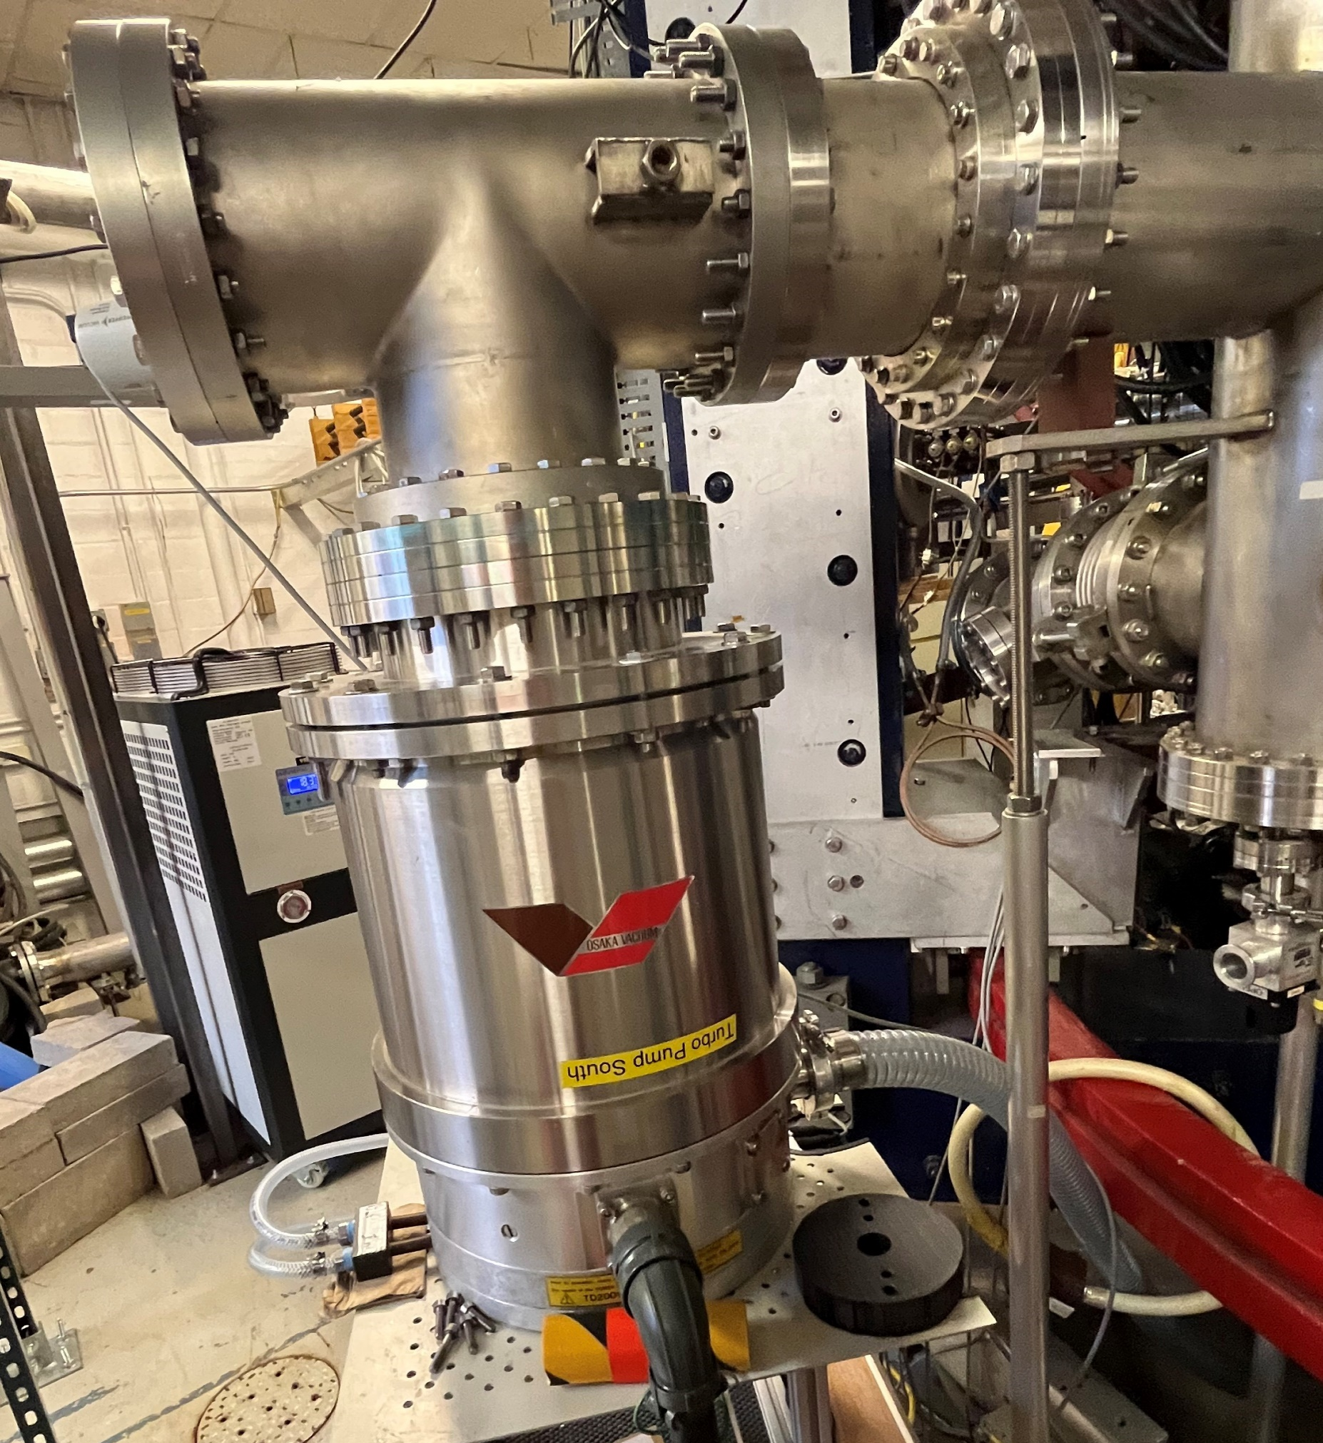
Observations: (Describe what you saw in the laboratory today, describe equipment and other aspects, include diagrams)
The turbo vacuum pump (pictured below) that removes the rest of the particles contained in the vessel after the rough pump (not pictured) has removed enough particles to get into the mTorr regime.
One of the diagnostics used for this machine is the reciprocating Langmuir probe (pictured above). This specific model has three separate movements that allow it to extend and retract through the plasma in 400ms. While moving through the plasma, this probe takes measurements on the order of every cm. It is in the plasma for such a short time as to not contaminate it with the probe sputtering.
The magnetron (a smaller device is pictured above and no the one in the machine) sends microwaves into the plasma to provide it with energy through ohmic heating, which ionizes the helium in the vessel.
(It can ionize any gas, but currently, helium is being run.)

Slide 6
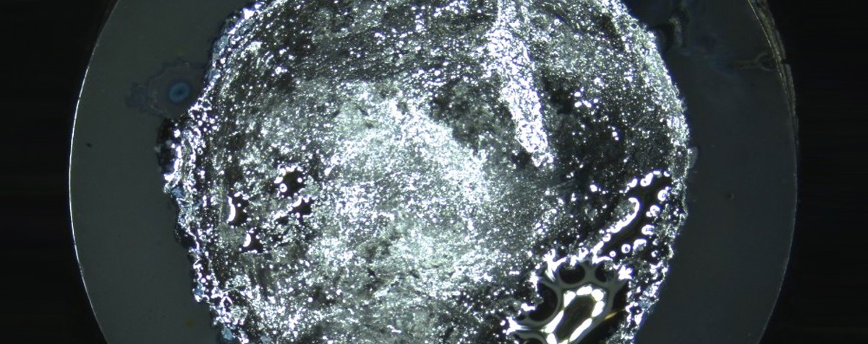
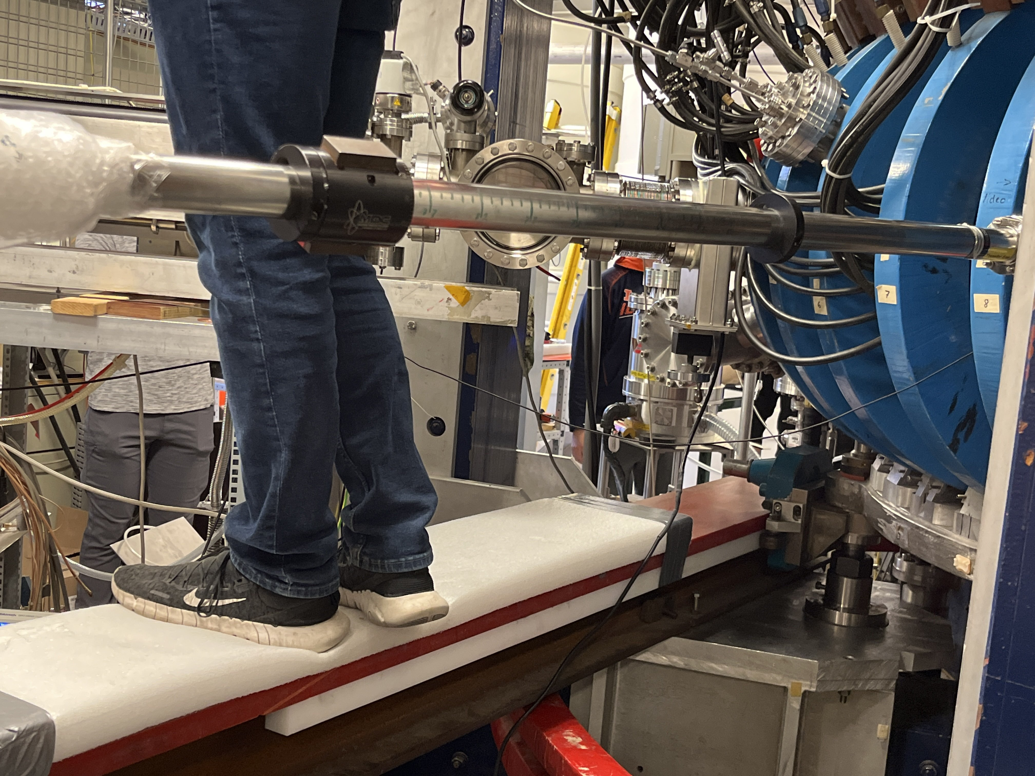
Observations (continued):
The magnetic/Hall probe (pictured below) is a diagnostic that measures the magnets and checks on their durability.
Liquid lithium (pictured above) is used as the diverter in this reactor, which is the device that removes heat from the reactor. The goal of a diverter is to absorb as much heat flux as possible to remove the need for special containment elsewhere. The reason a liquid is chosen is that it cannot melt and still traps the helium ash and can remove it from the system. Lithium specifically is being used because, when it is vaporized, it goes into the plasma and removes all the contaminants (O, N) and sends them to the wall. There is ongoing debate if this is a viable method, but the Europeans believe that liquid Tin would be better instead.

Slide 7
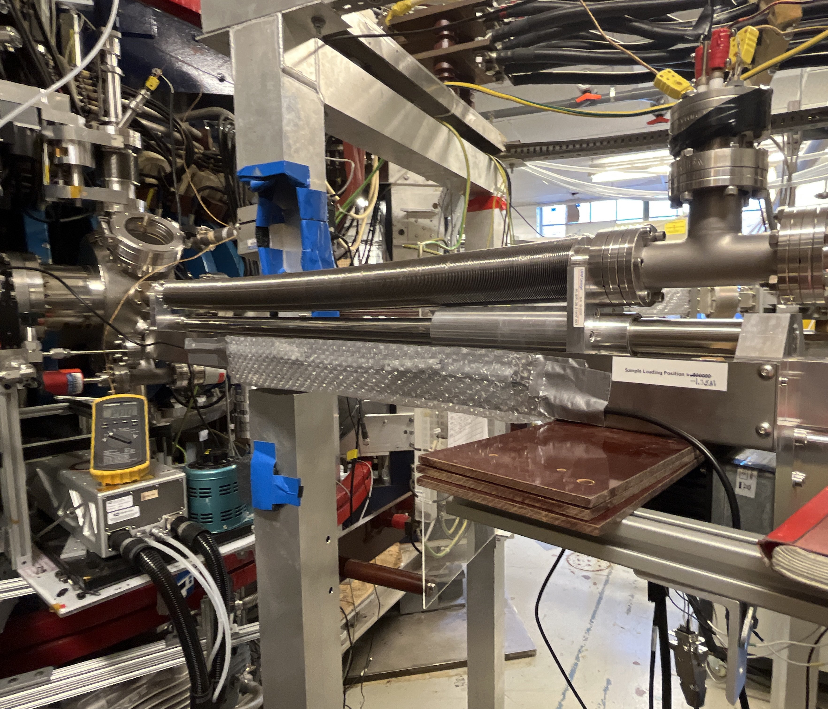
Observations (continued):
Hydramat (pictured below) is a diagnostic used for material characterization and sample insertion into the plasma vessel.
Other devices not pictured are the mass flow controller, which is what modulates the insertion of gas into the vessel, the spectrometers, which measure the composition of the plasma, and the residual gas analyzers, which measure the gas content trapped inside the wall of the vessel.

Slide 8
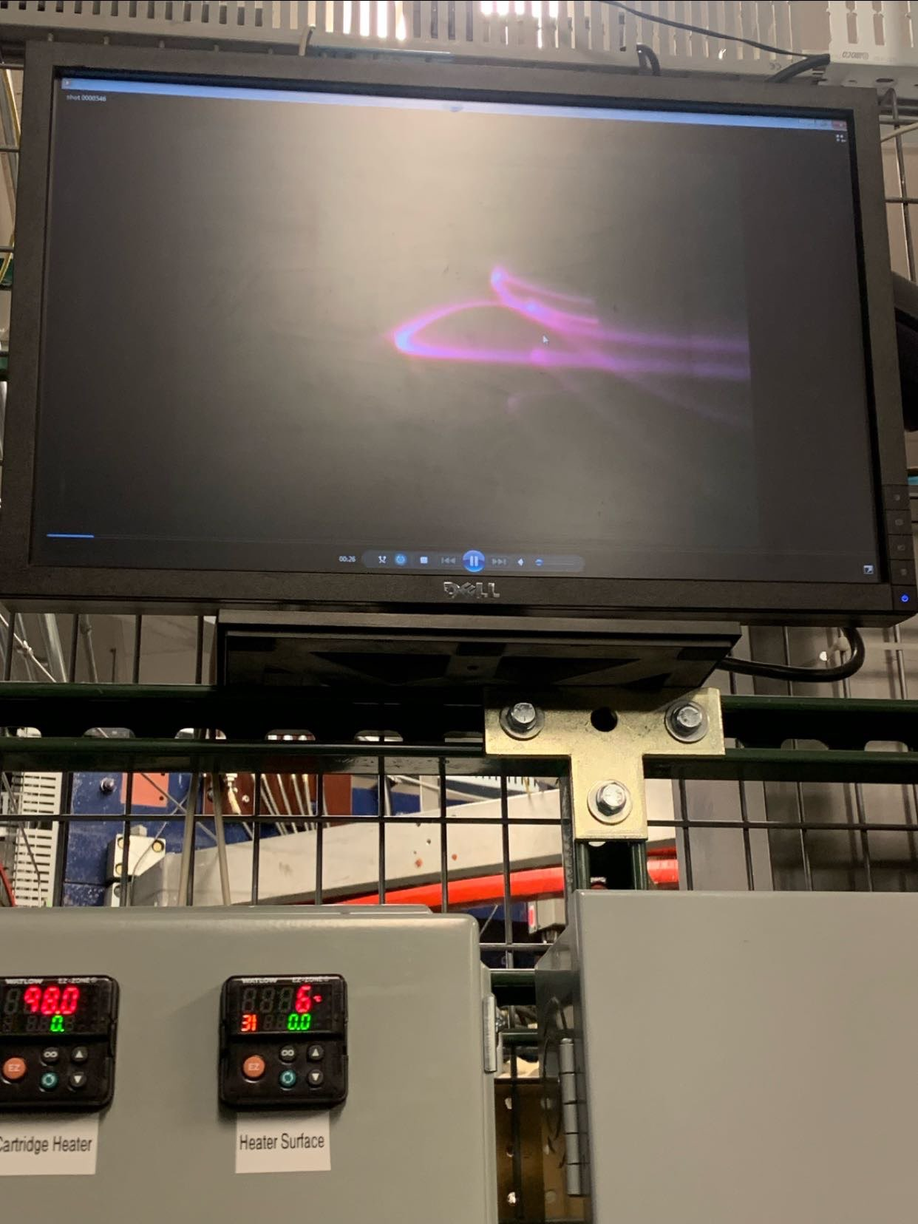
Discussion: (Discuss the results that were shown today, include any analysis)
The result of compiling all these contraptions together is to create a plasma like the one pictured to the left. However, in bigger and hotter machines and this machine when it is at full power, the plasma will be invisible unlike the one on the left, which is emitting light because it has not been fully ionized and transitions between electron orbitals is still occurring. In a full power or fusion plasma, the plasma would be invisible as all the gas in the vessel would be completely ionized and the electrons would have too much energy to recombine into a neutral. Once complete (say complete, but there will always be some recombination as temperature is on a Maxwellian distribution) ionization occurs, all of the energy inputted can be used to heat the plasma and not to dissociate electrons.

Slide 9
Summary: (Summarize what the laboratory was about and how it ties into lectures)
In this practicum, we looked at various types of plasma diagnostics that have been explained in class. A few examples of these were the Langmuir probe, magnetron, Hall probe, and spectrometers. We also saw the differences between a stellarator and tokamak in person and were able to see the different magnets each mode of operation uses. These magnets being: the blue, toroidal magnets used in both modes, the unpictured, central solenoid used in the tokamak mode, and the black helical coils used in the stellarator mode. Somethings we indirectly talked about were plasma material interactions, which were transiently being discussed when we talked about using liquid lithium as a diverter. We also discussed PMIs when we heard how fast the reciprocating Langmuir probe moved in and out of the plasma because it is made with a metal that would drain the energy from the plasma if it was sputtered off the probe.

